Slide 1
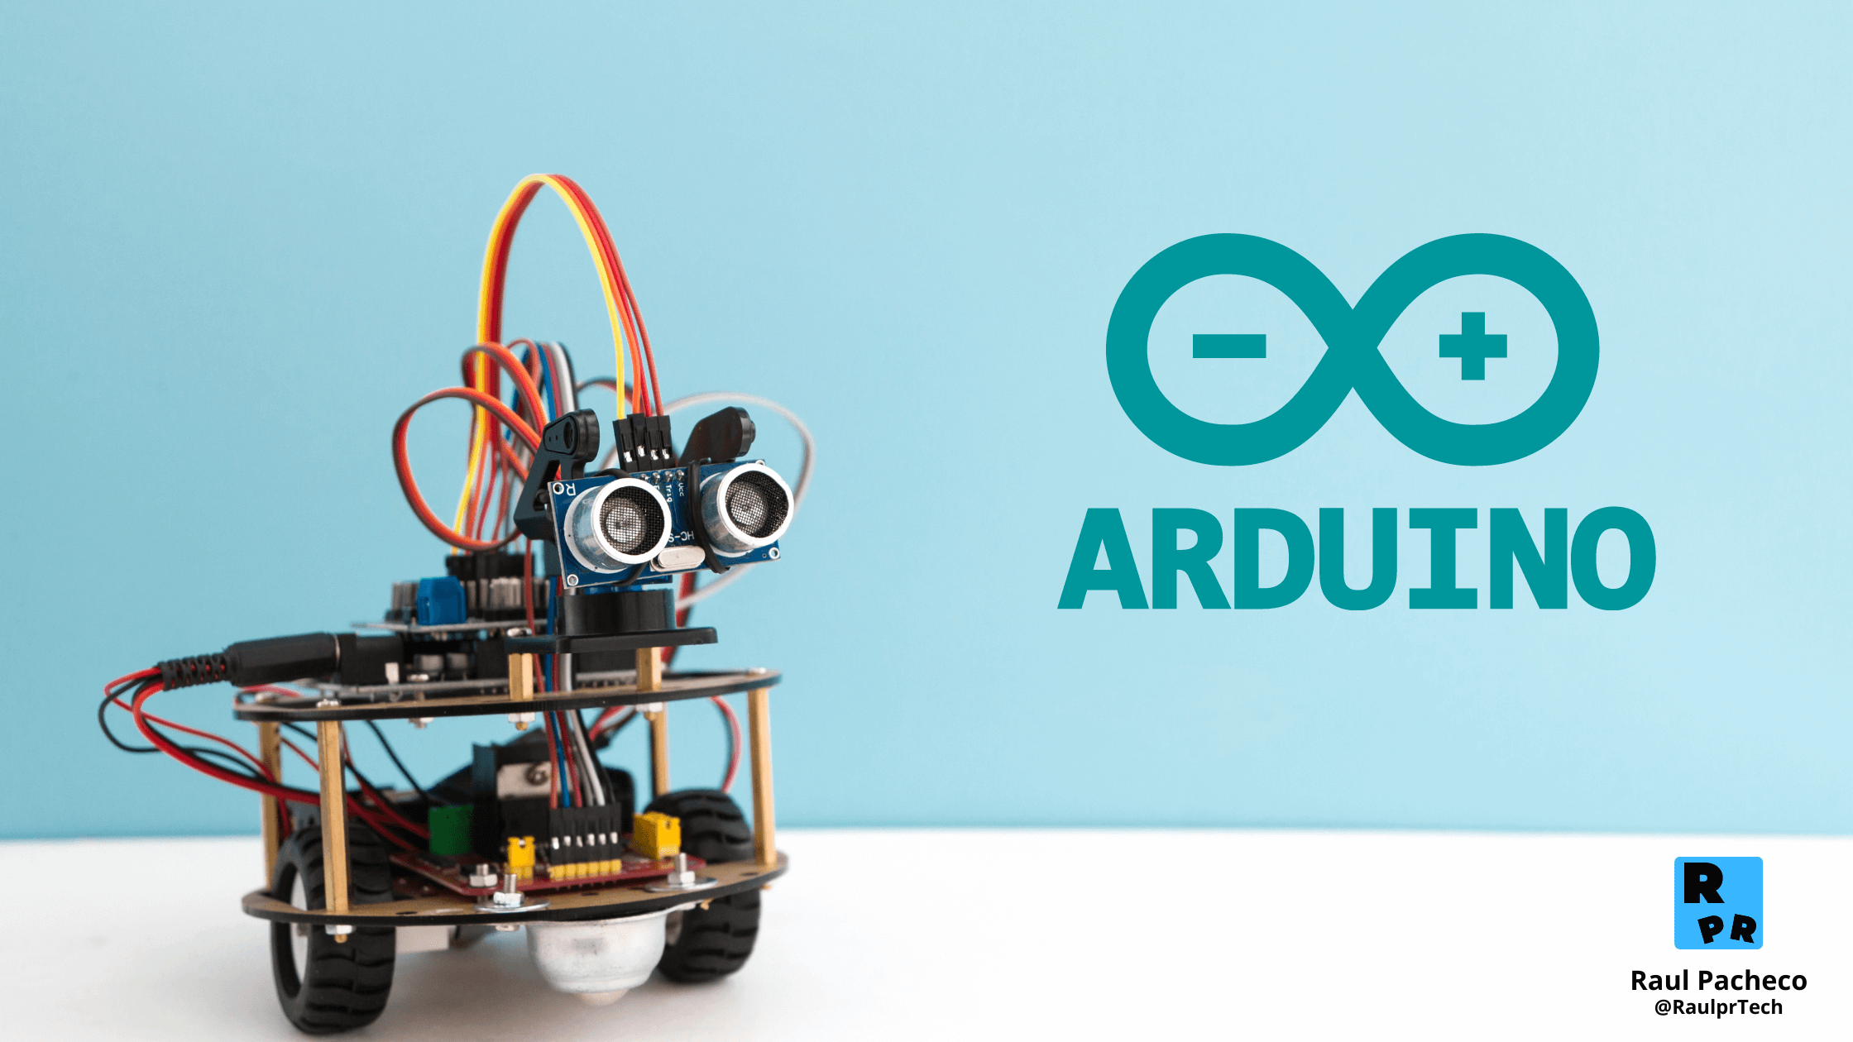


Slide 2
Presentation Overview
Introduction to Arduino
Why use Arduino
Popular Arduino Boards
Arduino IDE & Coding
Electronics Basics for Arduino
Interfacing Sensors & Modules
Arduino Communication Protocols
Introduction to IoT with Arduino
Advantages of Arduino
Disadvantages of Arduino
Libraries and Online Resources
Conclusion

Slide 3
Introduction to Arduino
Arduino is an open-source electronics platform based on easy-to-use hardware and software.
It’s intended for anyone making interactive projects.
Arduino is a powerful yet beginner-friendly open-source electronics platform designed for building interactive hardware projects.
It combines both a physical programmable circuit board (often referred to as a microcontroller) and a software development environment that makes writing code and uploading it to the board simple and accessible.

Slide 4
Why use Arduino
1. Simple Yet Powerful:
Arduino is an easy-to-use microcontroller platform designed for beginners and experts.
It simplifies electronics and programming with user-friendly tools and libraries.
2. Open-Source Ecosystem:
Both hardware and software are open-source.
Encourages community collaboration and rapid innovation.

Slide 5
3. Affordable and Accessible:
Low-cost boards make it suitable for students, hobbyists, and developers.
Available globally with strong documentation support.
4. Cross-Platform Compatibility:
Arduino IDE works on Windows, Mac, and Linux.
No need for expensive or proprietary tools.

Slide 6
Popular Arduino Boards
Board | Microcontroller | Digital I/O | Analog Pins | USB | Operating Voltage
UNO R3 | ATmega328P | 14 | 6 | USB-B | 5V
Mega 2560 | ATmega2560 | 54 | 16 | USB-B | 5V
Nano | ATmega328P | 14 | 8 | Micro-USB | 5V
Leonardo | ATmega32u4 | 20 | 12 | Micro-USB | 5V
Due | AT91SAM3X8E (32-bit) | 54 | 12 | USB | 3.3V
MKR1000 | SAMD21 Cortex-M0+ | 8 | 7 | Micro-USB | 3.3V
Nano 33 BLE | nRF52840 | 14 | 8 | Micro-USB | 3.3V
Portenta H7 | STM32H747 | 80+ | 16 | USB-C | 3.3V

Slide 7
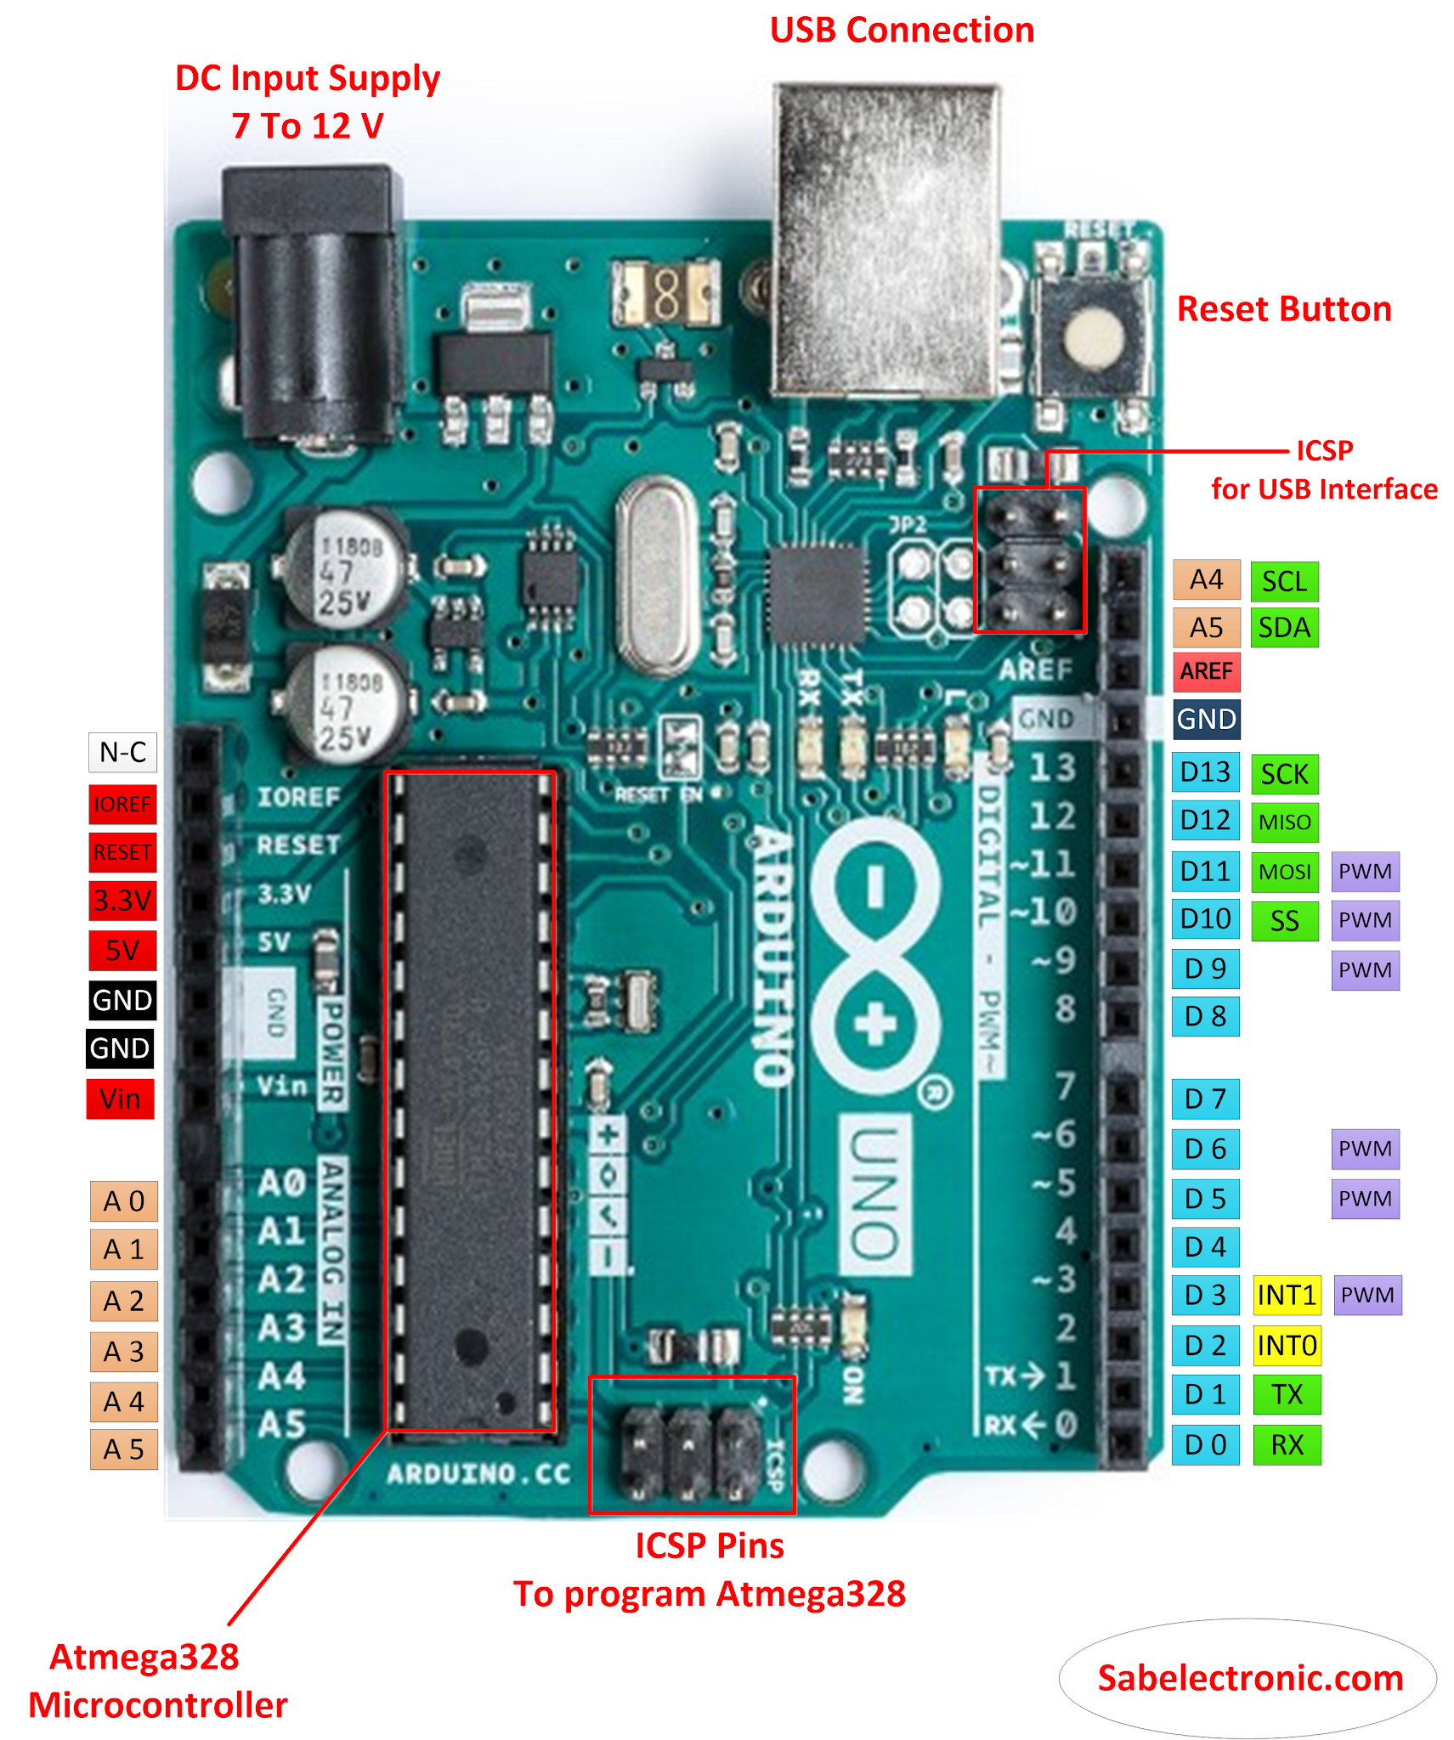
Arduino Uno (ATmega328P)
The Arduino Uno R3 is one of the most recognized and widely used development boards in the Arduino ecosystem.
Built around the ATmega328P microcontroller, the Uno R3 provides a reliable, affordable, and beginner-friendly platform for creating interactive electronic projects.
It is frequently used in education, DIY projects, and rapid prototyping by engineers, hobbyists, and students alike.
Figure : Arduino Uno R3

Slide 8
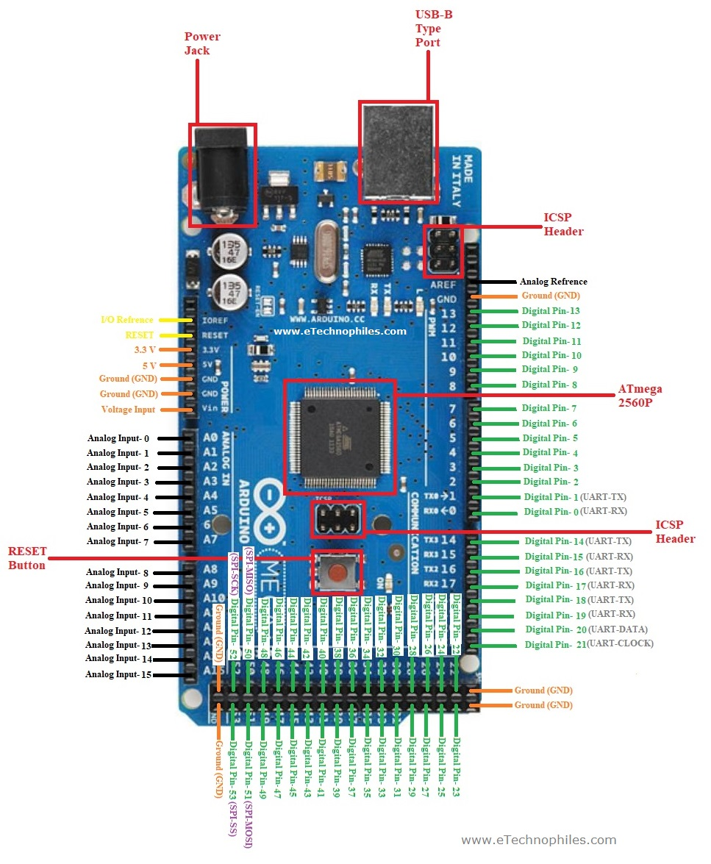
Arduino Mega 2560 (ATmega2560)
The Arduino Mega 2560 is a powerful development board designed for larger and more complex electronics projects.
It is built around the ATmega2560 microcontroller, which offers expanded memory, additional input/output pins, and more communication channels compared to standard Arduino boards like the Uno.
Because of its advanced features, the Mega 2560 is commonly used in robotics, 3D printers, automation systems, and multi-sensor applications.
Figure : Arduino Mega 2560

Slide 9
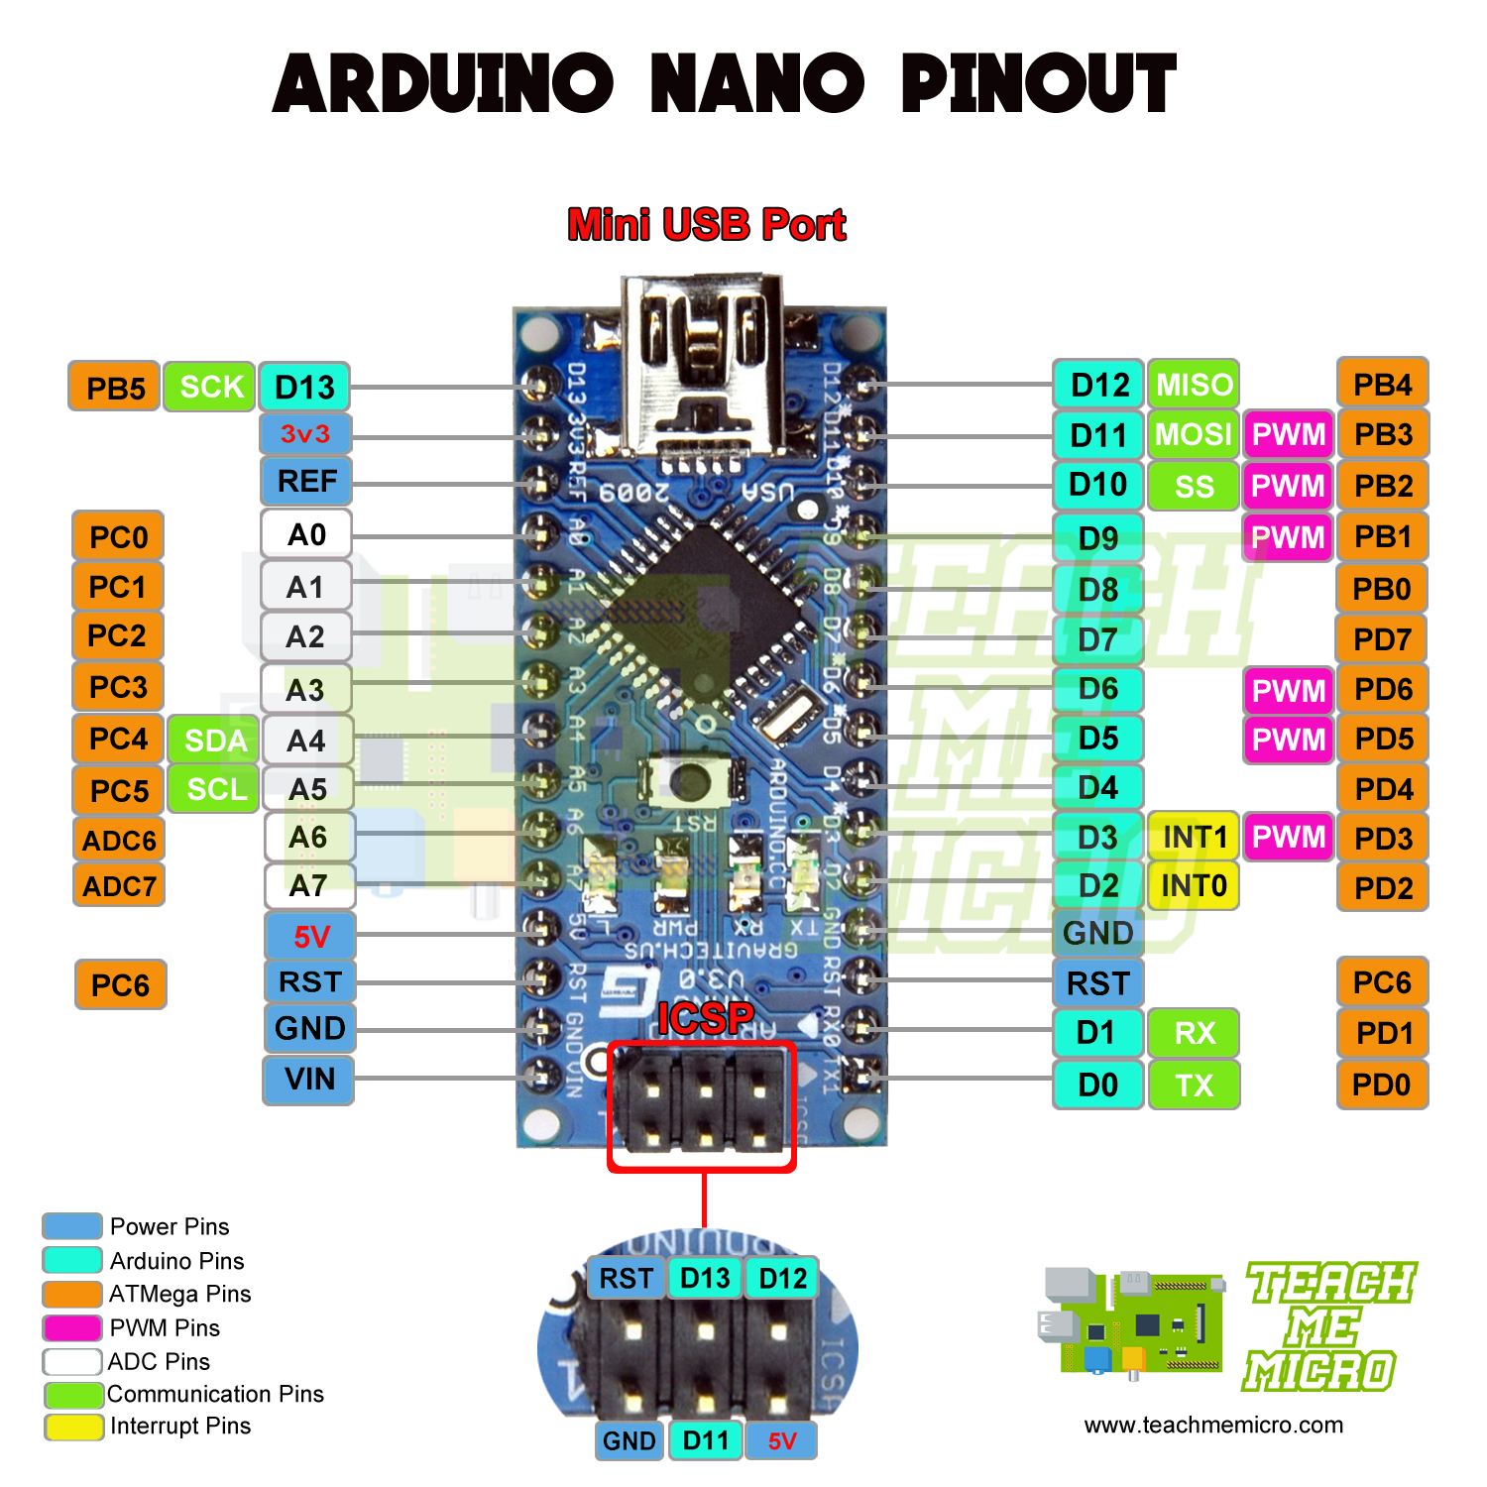
Arduino Nano (ATmega328P)
The Arduino Nano is a compact and lightweight microcontroller board based on the ATmega328P chip.
It offers similar functionality to the Arduino Uno but in a much smaller form factor.
Designed primarily for use in breadboards and space-constrained projects, the Nano has become a popular choice among hobbyists, students, and embedded developers.
Figure : Arduino Nano

Slide 10
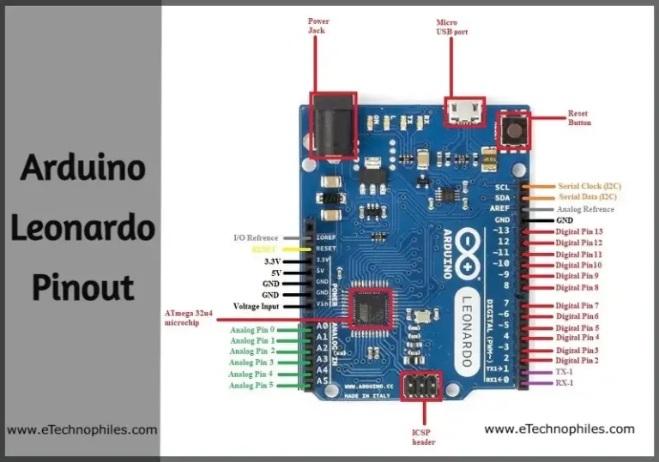


Arduino Leonardo (ATmega32u4)
The Arduino Leonardo is a unique and powerful member of the Arduino family, built around the ATmega32u4 microcontroller.
What sets the Leonardo apart from other popular Arduino boards—like the Uno or Nano—is its ability to directly handle USB communication, thanks to its integrated USB controller.
This board is particularly useful in applications were emulating a keyboard, mouse, or other human interface device (HID) is required.
Figure : Arduino Leonardo

Slide 11
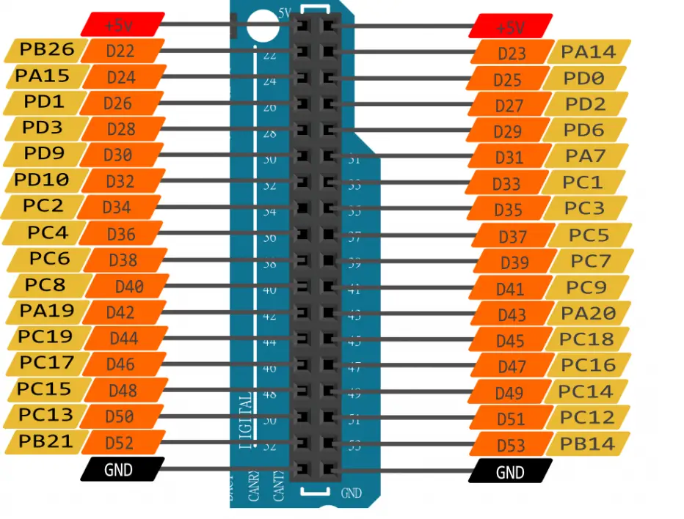
Arduino Due(AT91SAM3X8E – 32 bit)
The Arduino Due is a high-performance development board powered by the Atmel SAM3X8E microcontroller, which is based on the 32-bit ARM Cortex-M3 architecture.
Unlike many traditional Arduino boards that use 8-bit AVR microcontrollers, the Due provides significantly higher processing power, memory, and advanced features, making it suitable for more demanding embedded systems and real-time applications.
Figure : Arduino Due

Slide 12
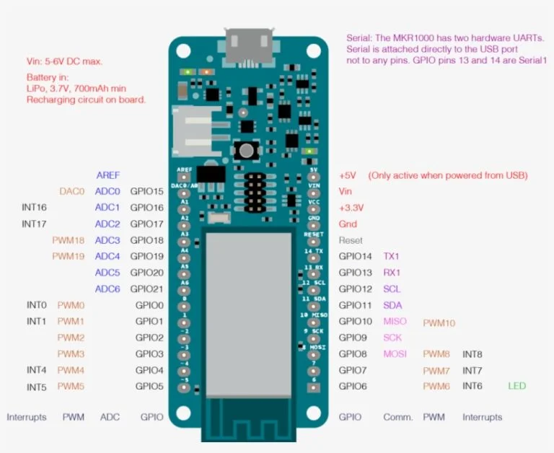
Arduino MKR1000 (SAMD21 Cortex-M0+)
The Arduino MKR1000 is a compact and powerful development board designed for Internet of Things (IoT) applications.
Built around the SAMD21 Cortex-M0+ 32-bit microcontroller from Microchip (formerly Atmel), it combines performance, ease of use, and built-in Wi-Fi connectivity in a small form factor.
The board is ideal for projects that require wireless communication, low power consumption, and secure data transmission.
Figure : Arduino MKR1000

Slide 13
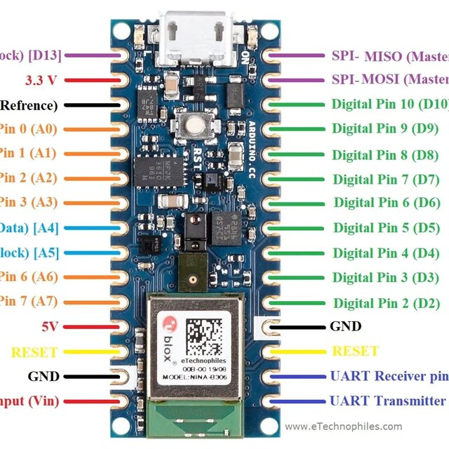
Arduino Nano 33 BLE (nRF52840)
The Arduino Nano 33 BLE is a compact, modern development board designed for low-power wireless applications.
It is built around the nRF52840 microcontroller by Nordic Semiconductor—a powerful, 32-bit ARM Cortex-M4F chip with Bluetooth 5.0 Low Energy support.
This board provides developers with the ability to create advanced, connected applications with ease, while maintaining a small footprint ideal for wearable and IoT solutions.
Figure : Arduino Nano 33 BLE

Slide 14
Arduino IDE & Coding
The Arduino Integrated Development Environment (IDE) is a software application used to write, compile, and upload code to Arduino boards.
It supports languages based on C and C++.
Key Features:
Simple and beginner-friendly interface
Built-in code editor with syntax highlighting
One-click verify (compile) and upload buttons
Access to predefined libraries and examples

Slide 15
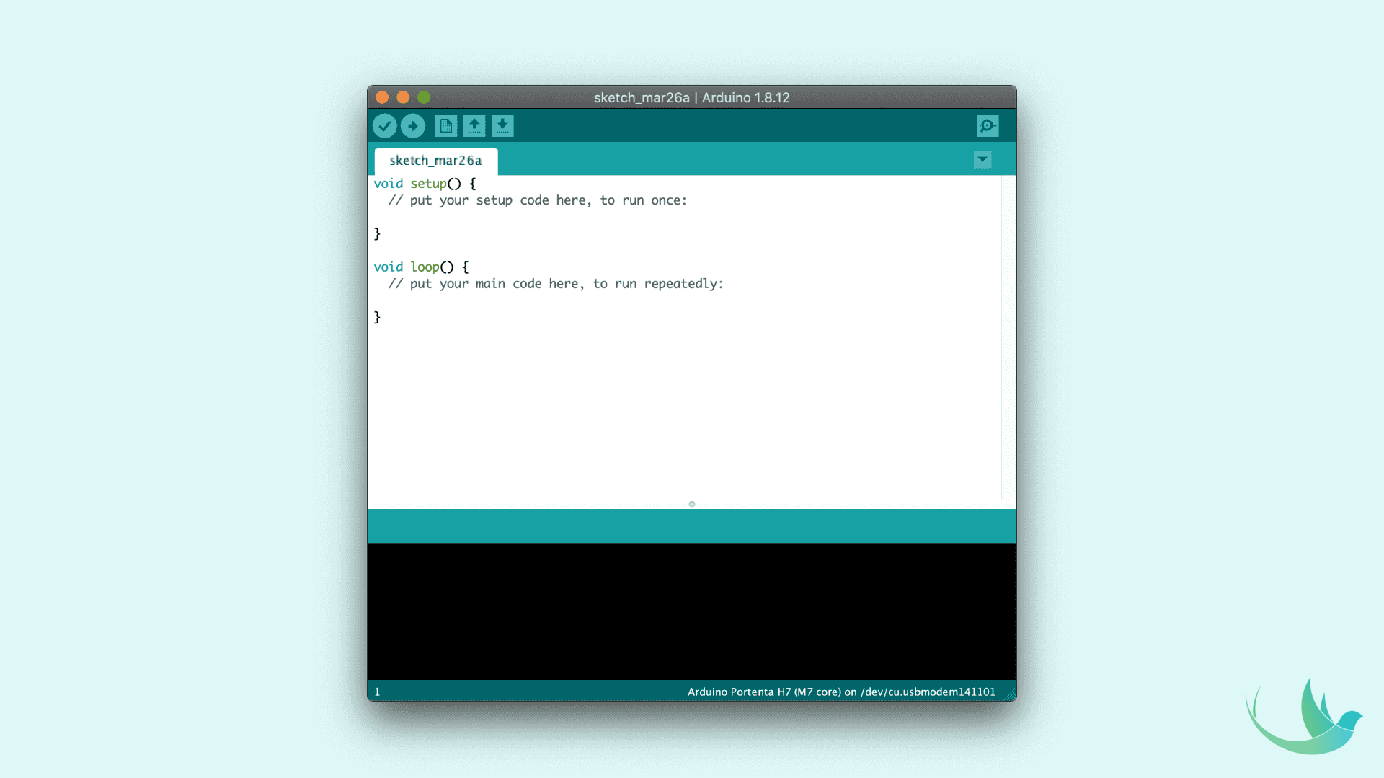
Supported Platforms:
Compatible with Windows, macOS, and Linux
Usage:
Write sketches (Arduino programs)
Select board and port
Upload code via USB to the Arduino board
Figure : Arduino IDE

Slide 16
Structure of Arduino Code:
setup() – Runs once at the beginning, used to initialize settings.
loop() – Runs continuously after setup(), contains the main program logic
Common Functions:
pinMode(pin, mode) – Set pin as INPUT or OUTPUT
digitalWrite(pin, value) – Set pin HIGH or LOW
digitalRead(pin) – Read digital input
delay(ms) – Pause program for specified milliseconds

Slide 17
Electronics Basics for Arduino
1.Resistors
Control the flow of electric current
Used to protect components like LEDs from overcurrent
2. LEDs (Light Emitting Diodes)
Emit light when current passes through
Require a resistor in series to limit current
3. Push Buttons
Simple switches used for user input
Often connected with pull-down or pull-up resistors

Slide 18
4. Sensors Convert physical parameters (like temperature or light) into electrical signals Examples: DHT11 (temperature/humidity), LDR (light sensor) 5. Potentiometers Variable resistors used to adjust voltage or create analog input 6. Breadboard Tool for prototyping circuits without soldering Allows quick testing and experimentation Reminder: Always double-check voltage and current ratings of components to avoid damage.

Slide 19
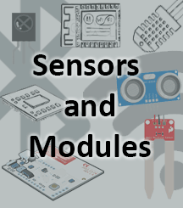
Interfacing Sensors & Modules
One of the biggest advantages of using Arduino in electronics projects is its ability to interface seamlessly with a wide variety of sensors and modules.
These external devices allow the Arduino to interact with the real world—by detecting physical phenomena and controlling hardware like displays, motors, and appliances.

Slide 20
Arduino Communication Protocols
Communication is a key aspect of Arduino projects, especially when interfacing with sensors, modules, other microcontrollers, or computers.
Arduino boards support multiple communication protocols that allow efficient data transfer between devices.
The most commonly used protocols in Arduino development include Serial (UART), I2C (Inter-Integrated Circuit), and SPI (Serial Peripheral Interface).
Each protocol serves different needs in terms of speed, wiring complexity, and use cases.

Slide 21
Introduction to IoT with Arduino
The Internet of Things (IoT) refers to a network of physical devices connected to the internet that collect, share, and act on data.
From smart homes and wearable devices to industrial automation and agriculture, IoT has revolutionized the way machines interact with the environment and with each other.
One of the most accessible platforms for building IoT systems is the Arduino, a family of open-source microcontroller boards ideal for beginners and professionals alike.

Slide 22
Advantages of Arduino
Easy to Use for Beginners
Open-Source Platform
Cost-Effective
Wide Community Support
Flexible and Compatible
Quick Prototyping

Slide 23
Disadvantages of Arduino
Limited Processing Power
No Built-in Multitasking
Lower Memory Capacity
Less Power Efficient
No Built-in Debugging Tools
Not Ideal for Commercial Products

Slide 24
Libraries and Online Resources
Arduino Libraries
Arduino Official Website
GitHub Repositories
Arduino Forum
YouTube Tutorials & MOOCs

Slide 25
Conclusion
Arduino is a powerful tool for building electronic projects with ease and creativity.
It offers a perfect blend of simplicity, flexibility, and affordability, making it ideal for learners and innovators.
From basic circuits to smart systems, Arduino provides a solid foundation for exploring the world of embedded systems and IoT.
Its open-source nature and vast community support empower users to learn, experiment, and innovate without limits.

Slide 26
Thank You

